Slide 1

Course Code: MATH 211
Course Title: MATH III
Lecture 2 (Laplace Transform)
Tazin Tamanna
Lecturer in Mathematics
Department of Science and Humanities
M.Sc. in Applied Mathematics (KU)
B.Sc. in Mathematics (KU)

Slide 2
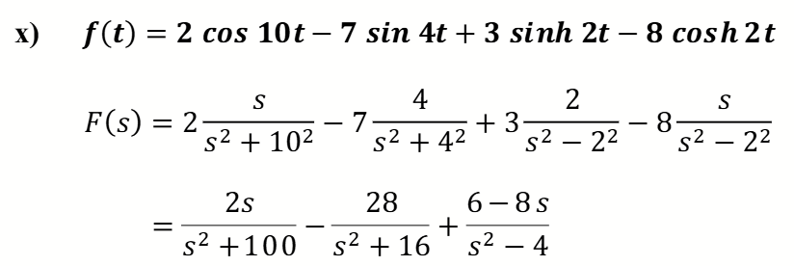
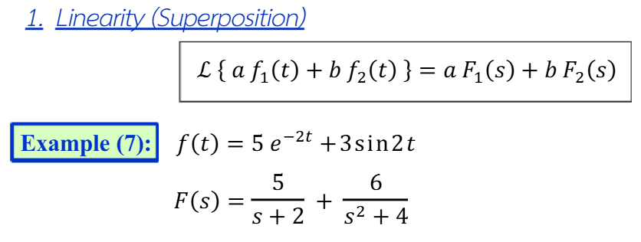
Module II: Some Properties of Laplace Transform and Related Examples

Slide 3
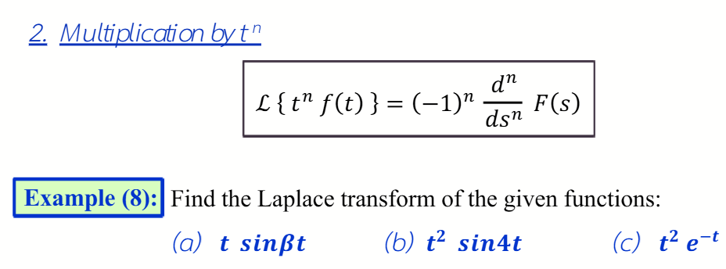
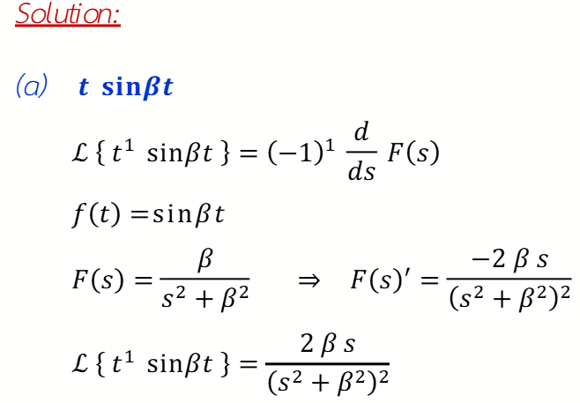

Slide 4
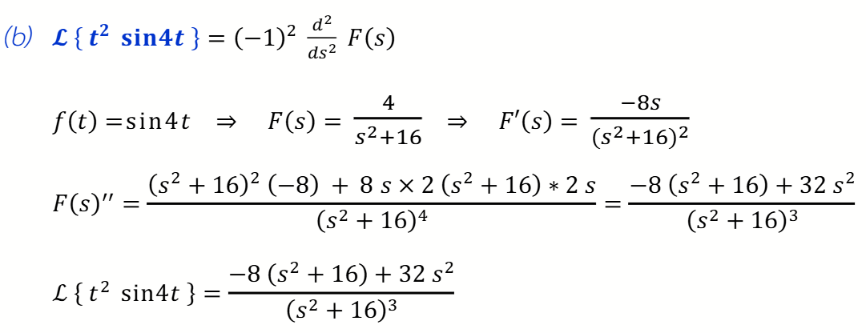
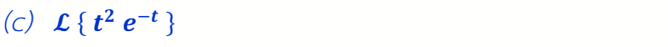

Do Yourself. Ans:

Slide 5

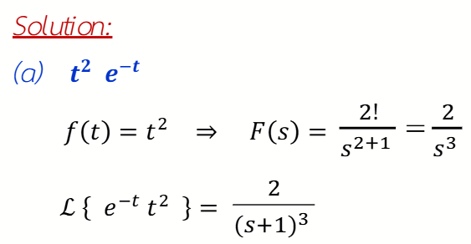

Slide 6
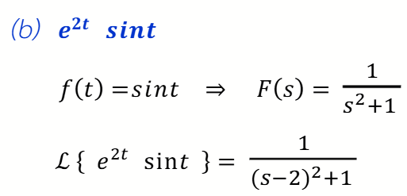



Do Yourself. Ans:

Slide 7
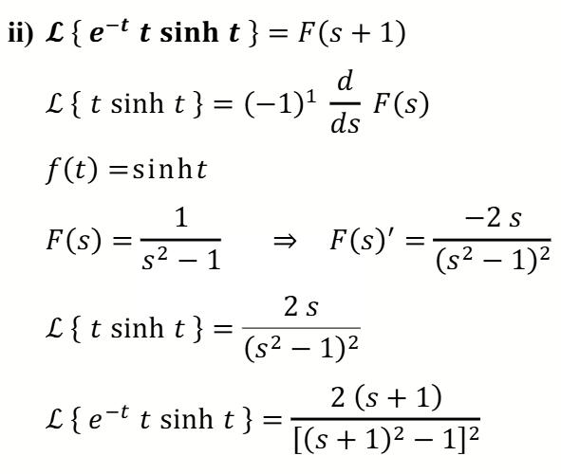

Slide 8
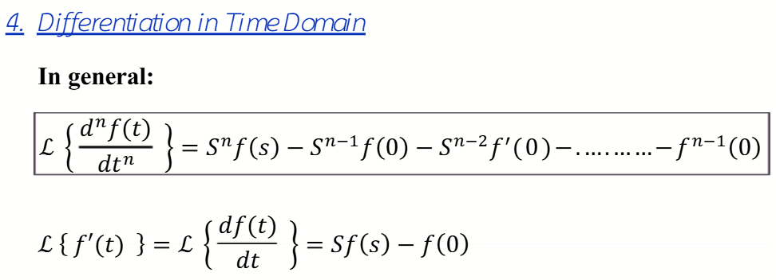


Slide 9
